Slide 1
Know Your Faith IV: The Fathers of the Church
Lesson 2: St Justin Martyr,
The Philosopher and Apologist

Slide 2
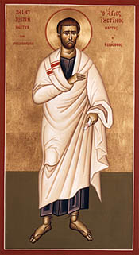
We shall not injure God by remaining ignorant of Him, but shall deprive ourselves of His friendship.
– Fragment VII

Slide 3
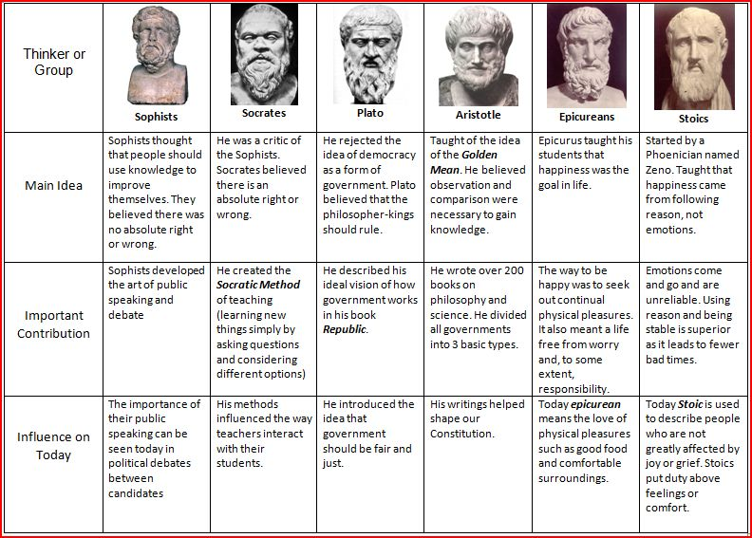

Slide 4
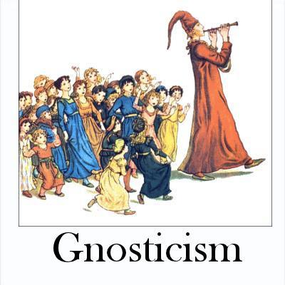

Slide 5
Persecutions of the Early Church
The First Persecution, Under Nero, A.D. 67
The Second Persecution, Under Domitian, A.D. 81
The Third Persecution, Under Trajan, A.D. 108
The Fourth Persecution, Under Marcus Aurelius Antoninus, A.D. 162
The Fifth Persecution, Commencing with Severus, A.D. 192
The Sixth Persecution, Under Maximus, A.D. 235
The Seventh Persecution, Under Decius, A.D. 249
The Eighth Persecution, Under Valerian, A.D. 257
The Ninth Persecution Under Aurelian, A.D. 274
The Tenth Persecution, Under Diocletian, A.D. 303

Slide 7
Writings of St Justin
The Two Apologies
Dialog with Trypho the Jew
On the Resurrection
A Discourse to the Greeks
Exhortation to the Greeks
On Monarchy
Exposition of the Faith
Letter to Zenas and Serenus
Answers to the Orthodox
The Greek's Questions to the Christians
Refutation of Certain Aristotelean Theses
The Psalmist
On the Soul

Slide 8
